Slide 1
Snakebite at ER
Dr Dayal Bandhu Majumdar
dayalbm@gmail.com
Technical Advisor (Snakebite),ICMR.
State Resource Person, W B ( S B Training)
9433104233
www.dayalbandhu.vip

Slide 2
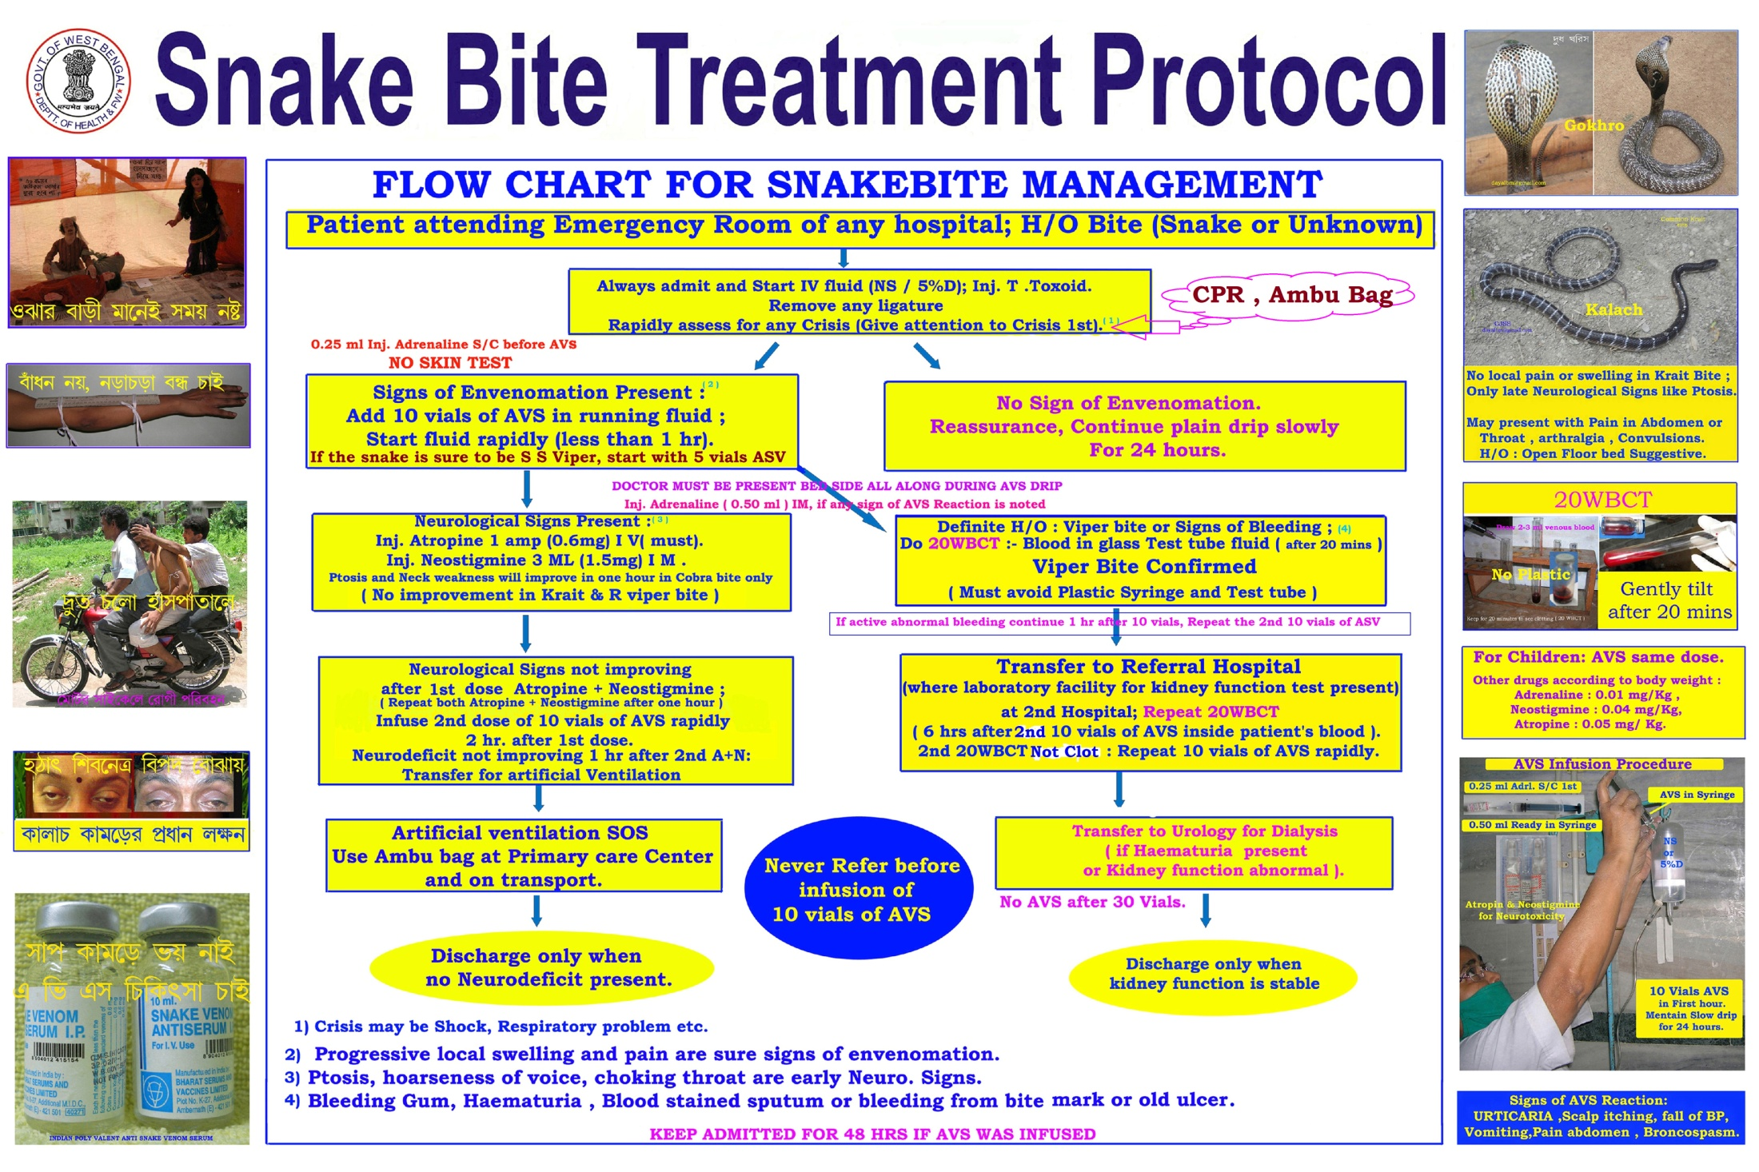
Single Page State Protocol

Slide 3
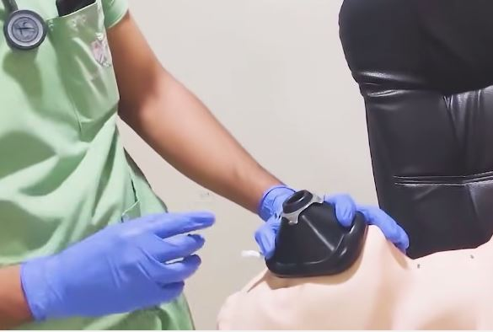
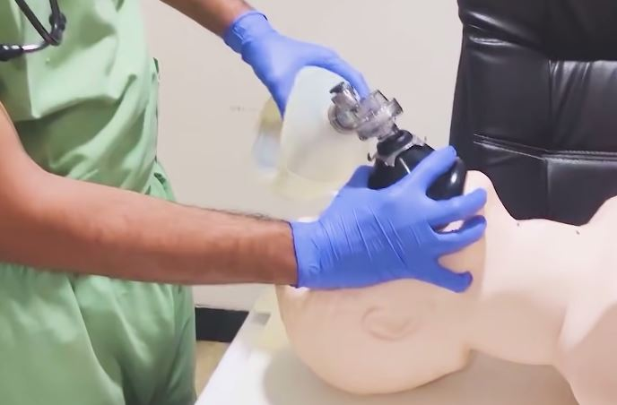
Ambu Bag & Mask
Start Bag & Mask ventilation.
Take Skilled Support for Intubation.
Intubate before Transfer.

Slide 4
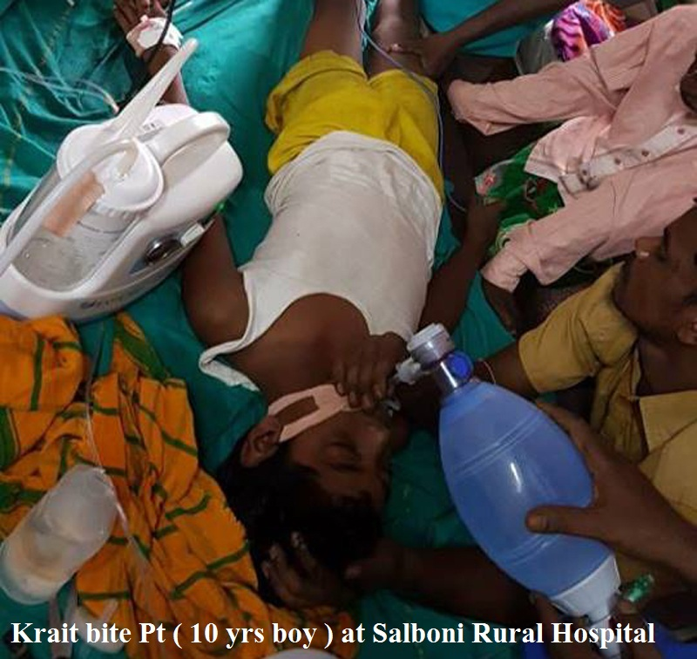

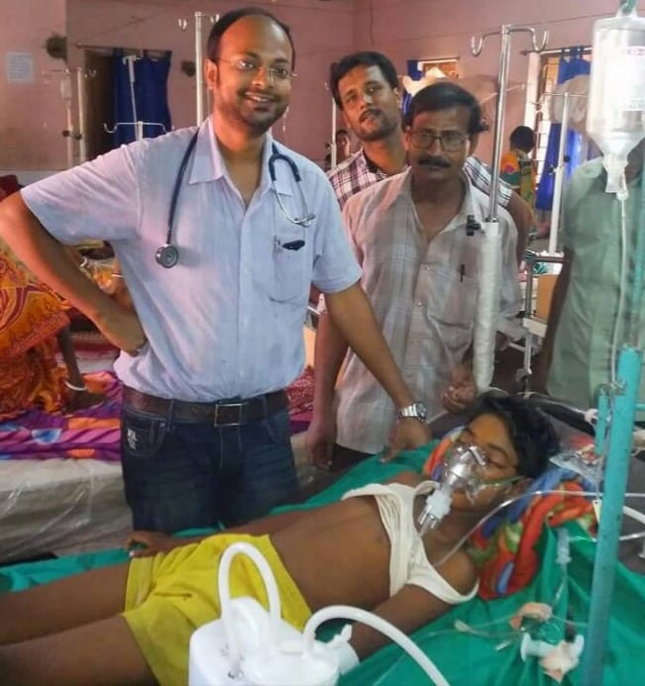
Intubate & Ambu Bag
Dr Alam of Salboni Proved it (14.6.17)

Slide 5
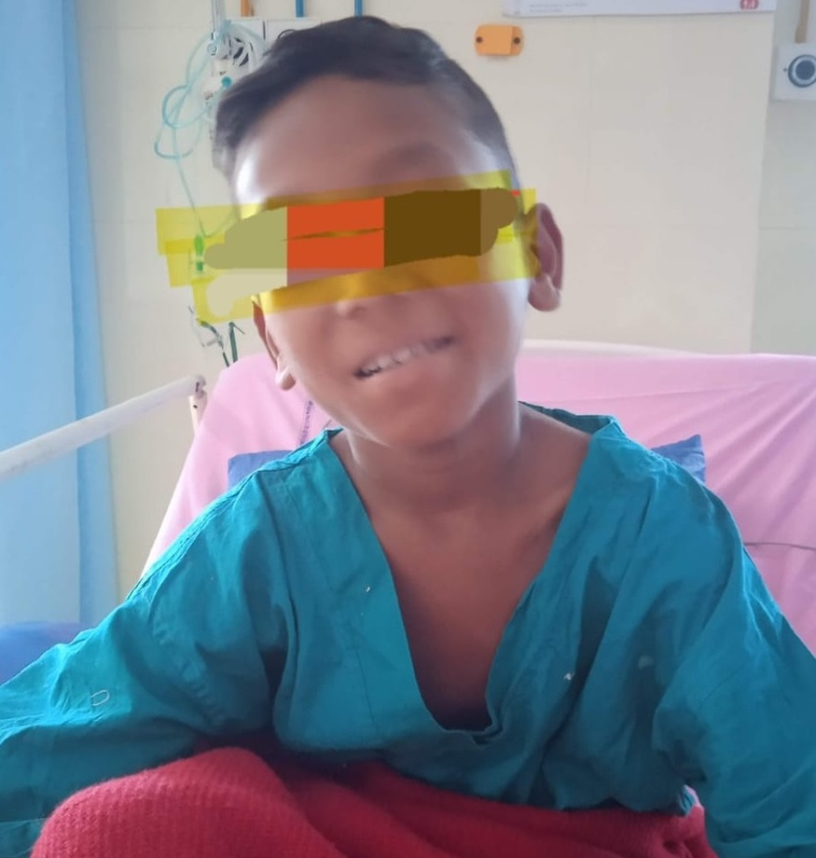
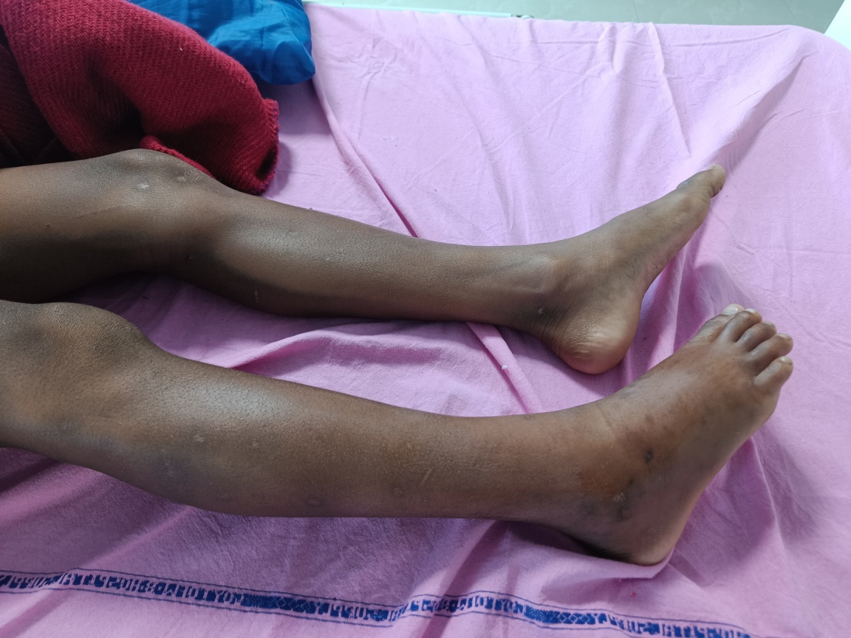
CPR & Ambu Bag
Dr Chayan Dutta of Malbazar SD Hosp(19.7.25)
9 Yrs Boy, Cobra Bite , 4 hrs ago.
Cardiac Arrest, No Respiration – CPR at ER.
Intubated, ASV ( 20 vials), AN, ITU ( Adult)

Slide 6
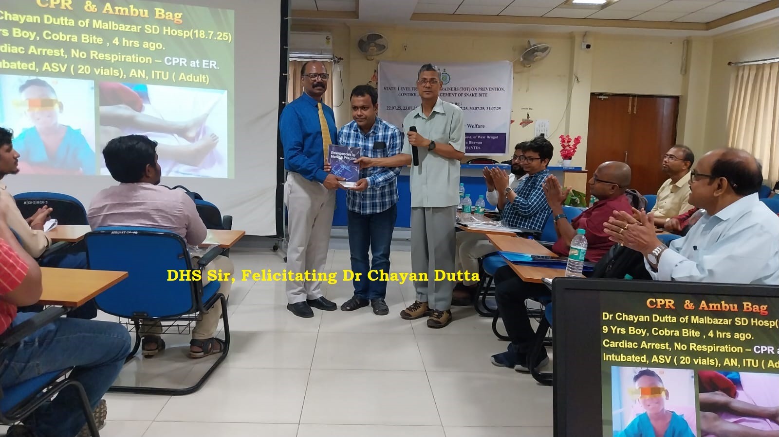
Ambu Bag can Save a Life
DHS Sir Felicitating Dr Chayan Dutta (22.7.25)

Slide 7
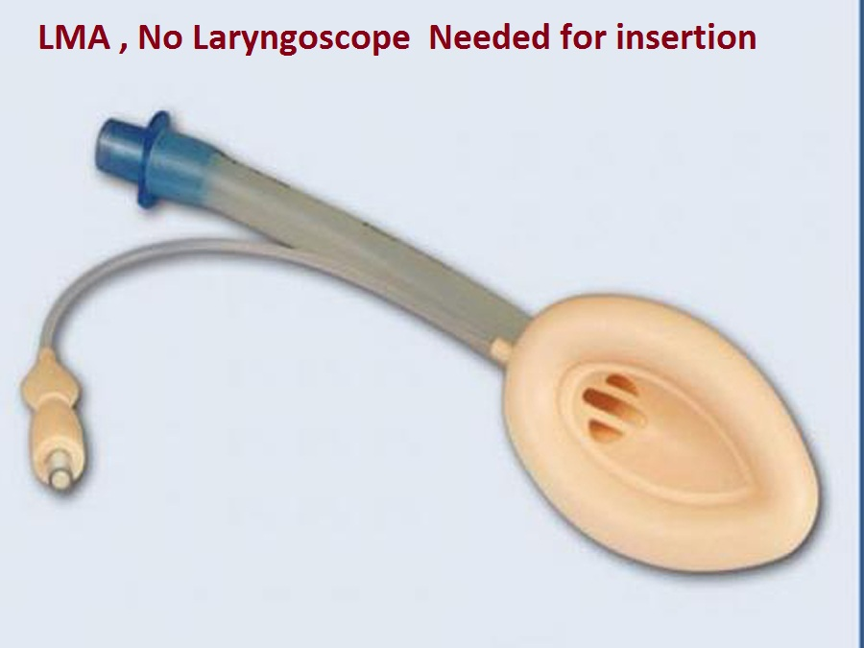
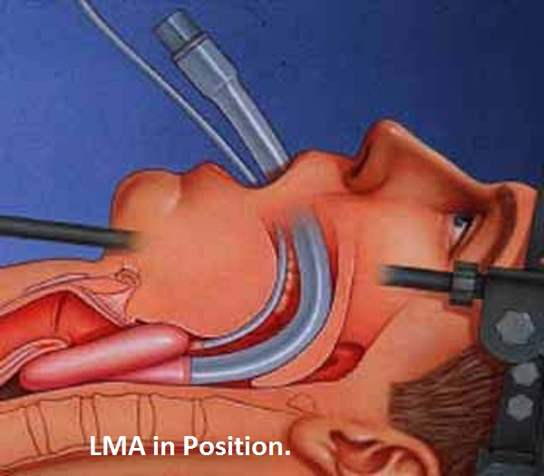
LMA / ET Tube & VENTILATOR
LMA needs no Laryngoscope.
Endo-tracheal Tubes ideal.
An Ambu bag with Tube = Lifesaving.

Slide 8
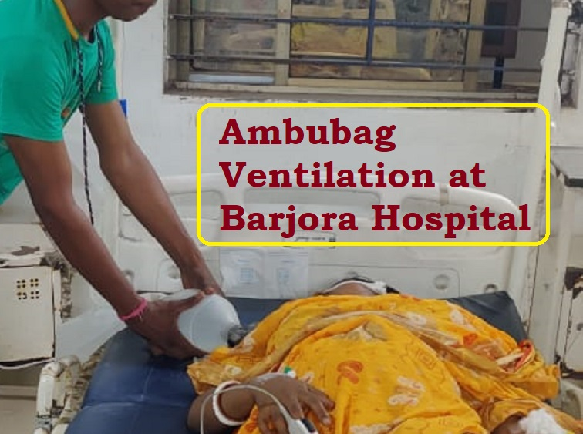
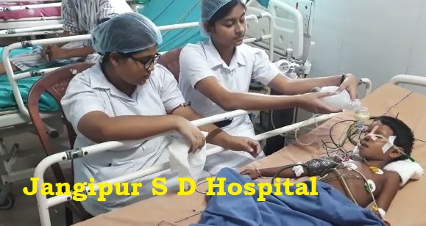
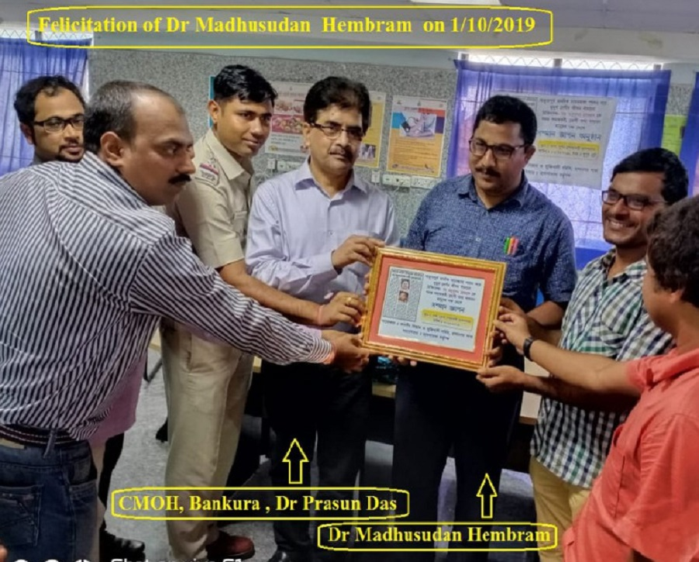
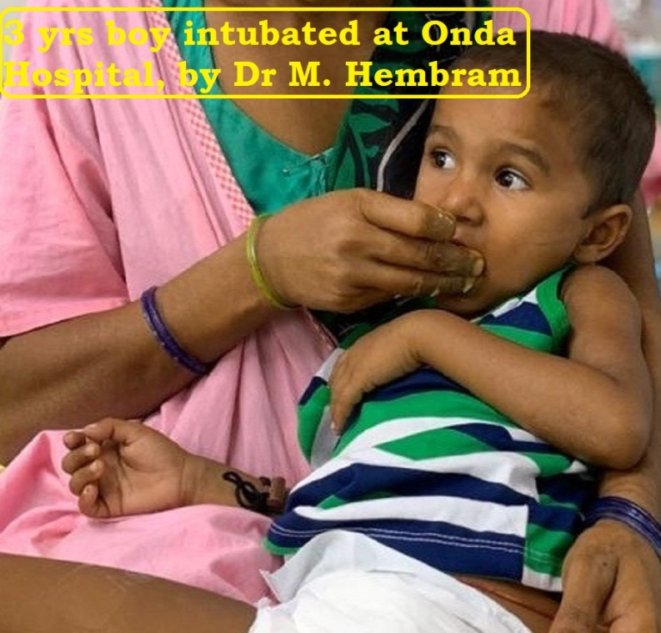
Transport with Ambu Bag

Slide 9
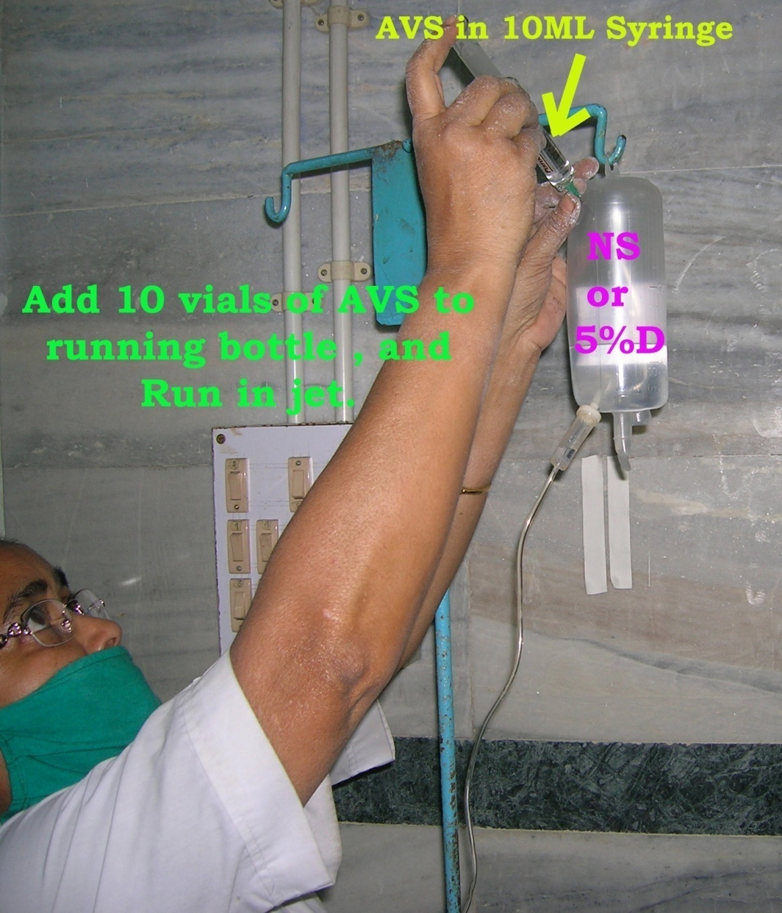
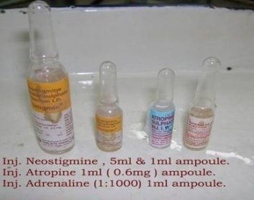
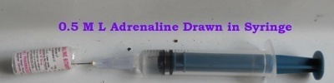
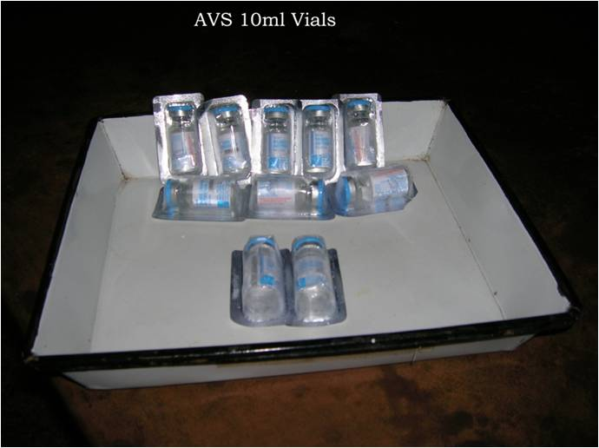

ASV Infusion Procedure
0.25ML Adrenaline S/C before ASV.
Keep 1/2 Ampoule Adrenaline ready in syringe.
First 10 vials ASV in one hour.
Maintain slow drip for 2nd regime of 10 vials SOS.

Slide 10
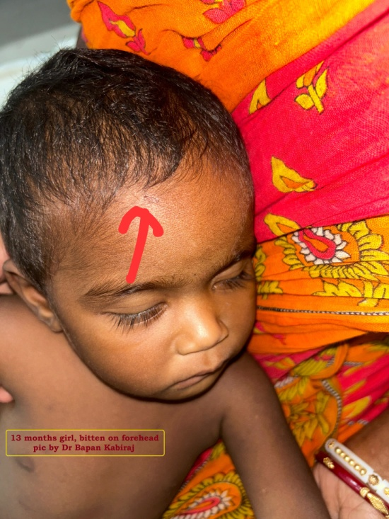
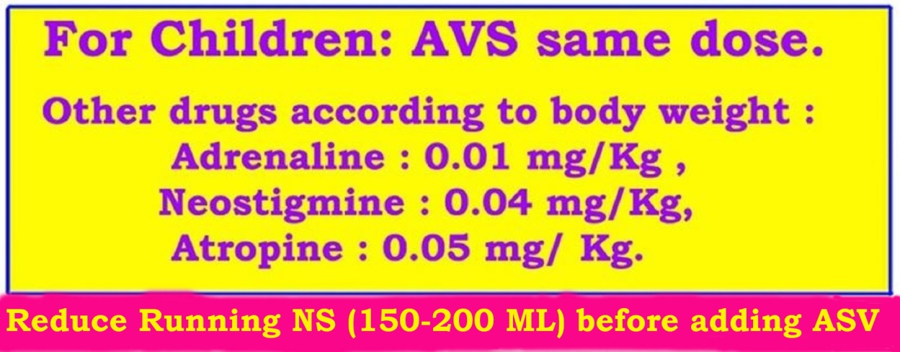
ASV For Children
This girl got 20 vials of ASV.
Keep in mind Fluid Overload ( Avoid).
Inj. Adrenaline : 0.01 mg/kg.
Inj. Neostigmine : 0.04 mg/kg.
Inj. Atropine: 0.05 mg/kg body wt.

Slide 11
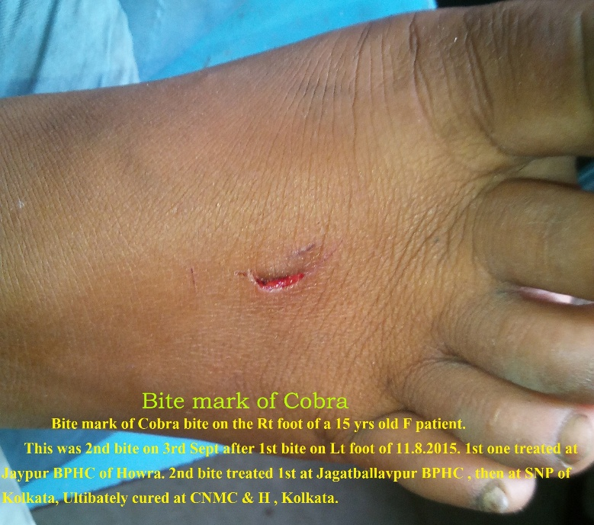
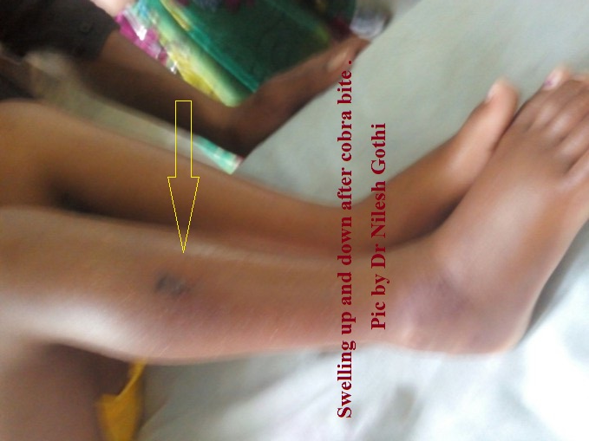
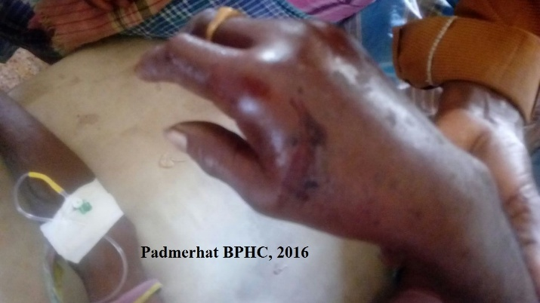
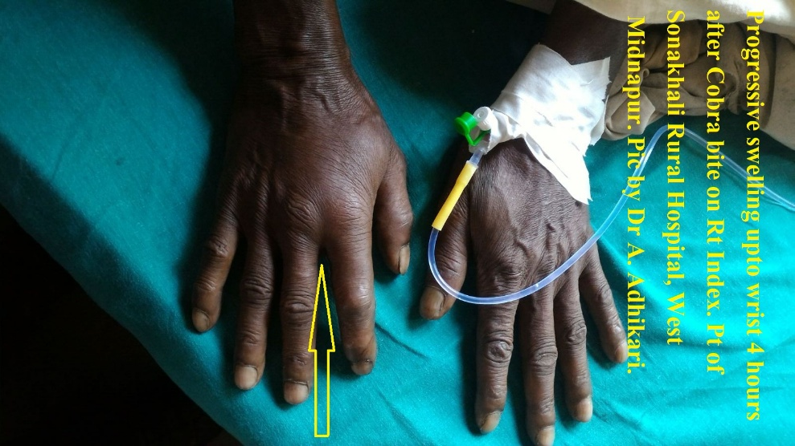
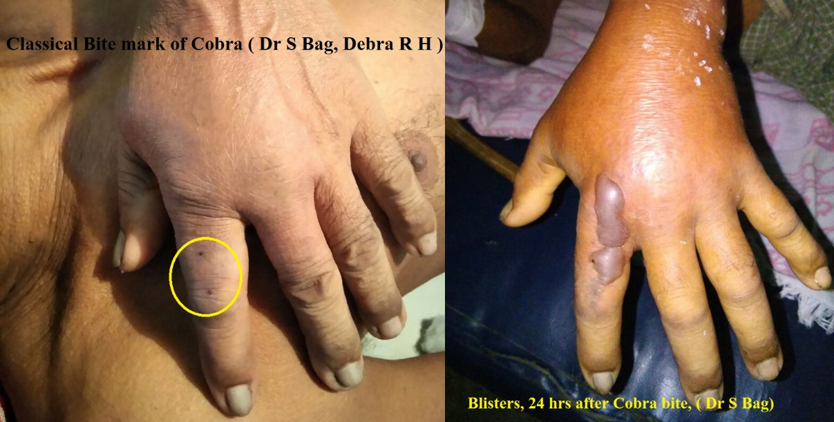
Cobra Bite Local signs
Variable Bite marks. Severe pain.
Progressive Swelling , may be Blisters.
Cellulitis or necrosis.

Slide 12
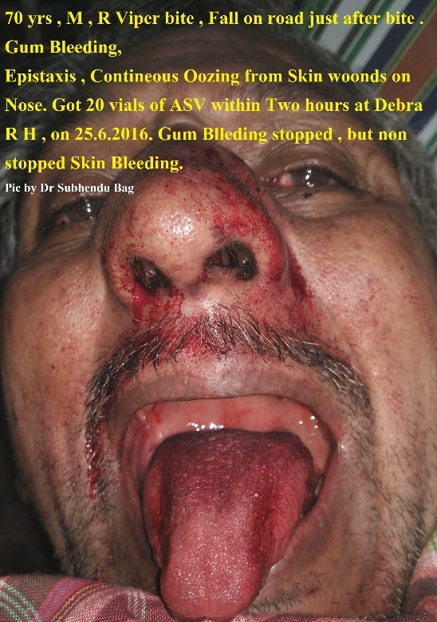
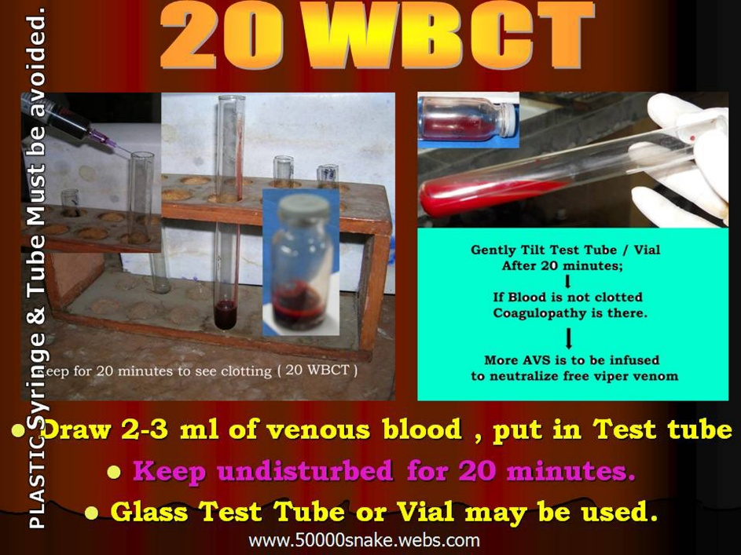
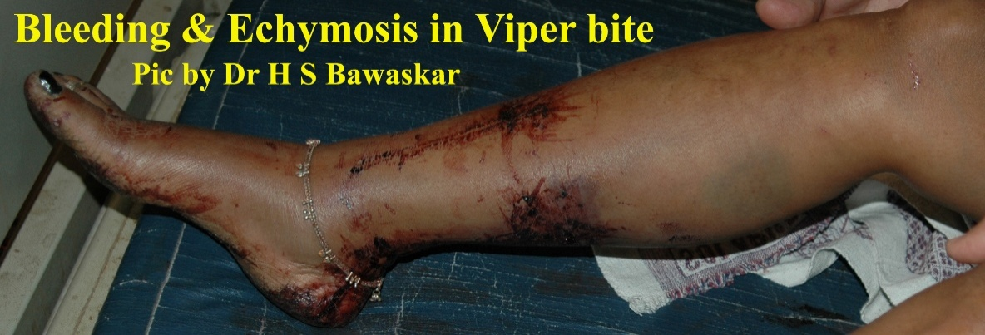
Hemotoxic Bites
Pain and Slow Swelling.
Sometimes ignored.
Bleeding from any site.
Clotting Disorder.
Late Hematuria.
Oliguria.
Acute Renal failure.

Slide 13
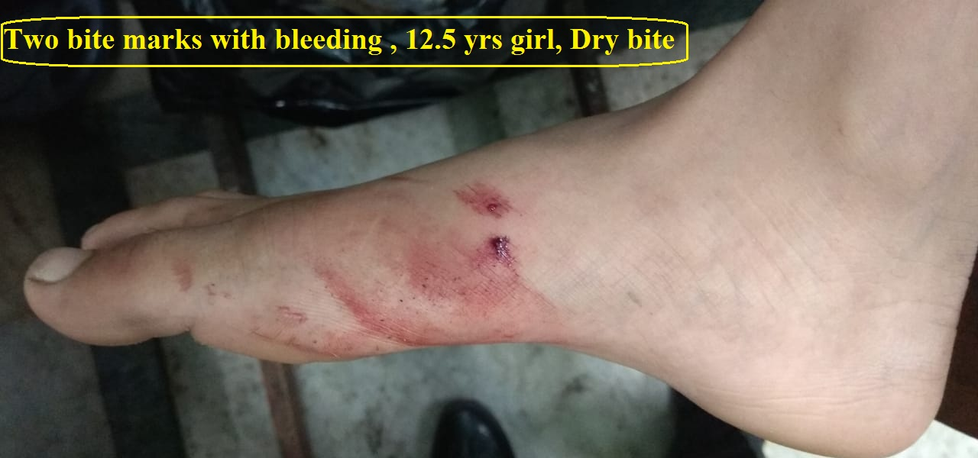
Bite Marks are of No Use
Bite marks are of no significance.
Never search for bite marks.
Bite marks with Dry Bites possible.
No bite marks – C. Krait bite possible.

Slide 14
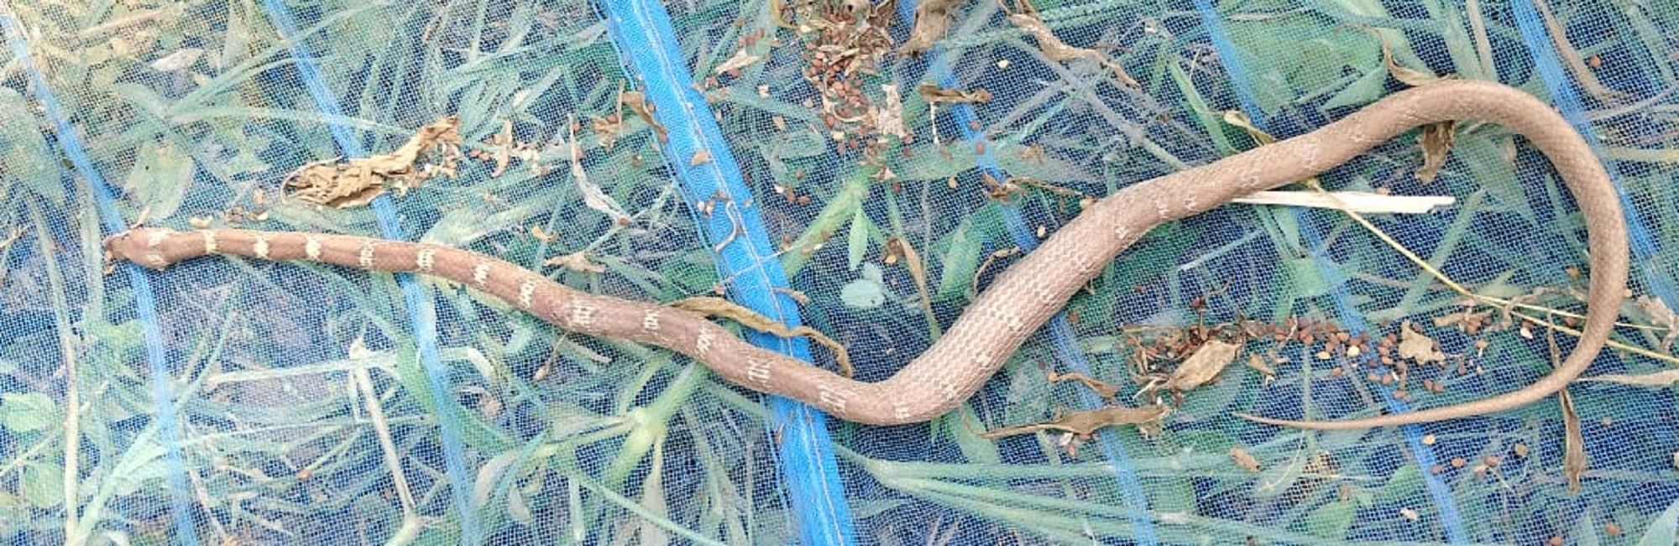
Snake Identified by PT
Doctor’s father Bitten.
Confident for snake identification.
Treatment started for R. Viper bite.
Snake picture identified as a Wolf snake.
So, Rely on clinical features only.

Slide 15
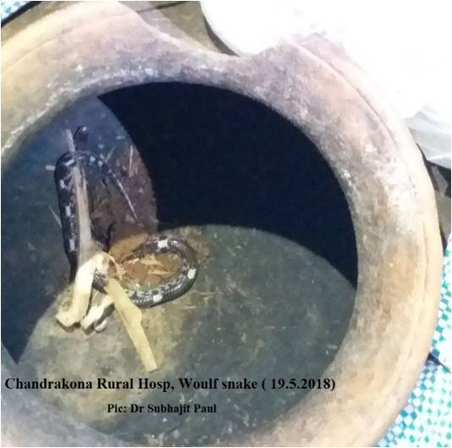

Snake Brought – Helpful ? : No
9yrs girl, bite at Foot; Pain & Swelling.
Wolf Snake ( Non-venomous) brought .
20WBCT= Not Clotting twice.
ASV Cured.

Slide 16
SKIN TEST ?
No Skin Test before ASV infusion.*
Skin test is of no value.
Mostly false negative.
ASV is lifesaving , so must be given.
SIGNS OF REACTION.
Urticarial rashes and scalp itching 80%
Sudden fall of BP , Vomiting .
Pain abdomen, bronchospasm.
Rarely angio-oedema.
* Prof. D A Warrell ; WHO SEARO Guideline, 2010(P-80).

Slide 17

Manage ASV Reaction
Prevent by 0.25 ML Inj. Adrenaline S/C* Any Signs of Reaction:
Stop IV infusion temporarily.
Inj. Adrenaline 0.5 ML IM ( Not S/C or IV)
Wait for 10 Mins , Restart IV infusion.
Adrenaline IM can be repeated after 10 Mins.
* H Asita de Silva et al : Plos , Neglected Trop Diseases. May 2011.

Slide 18
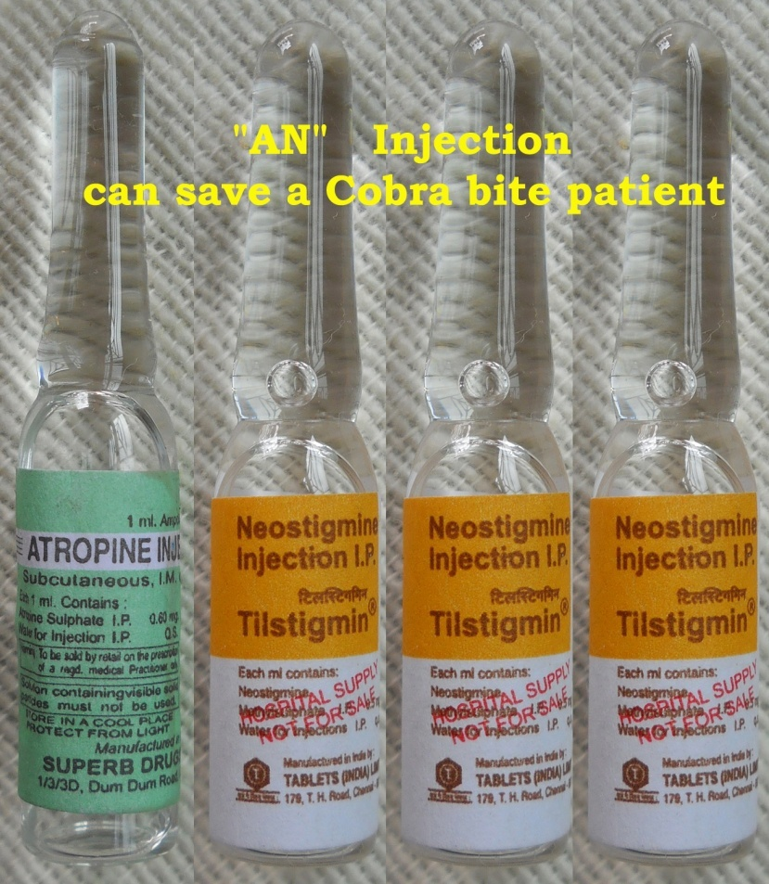
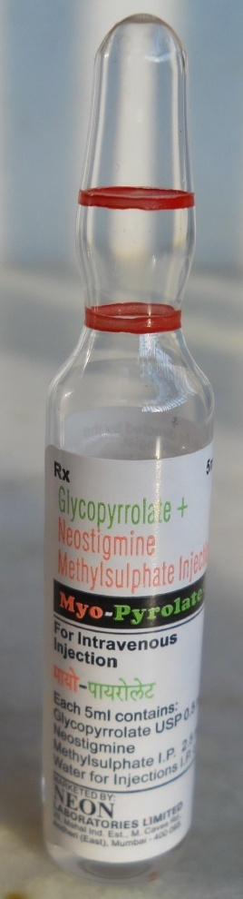
“AN” Injection Can Save
Always Atropine ( 0.6mg) 1amp. IV first.
3 ml Neostigmine IV/IM ( 1.5mg Adult).
Inj. Neost + Glycopyrolate ( IV Singly).
=

Slide 19
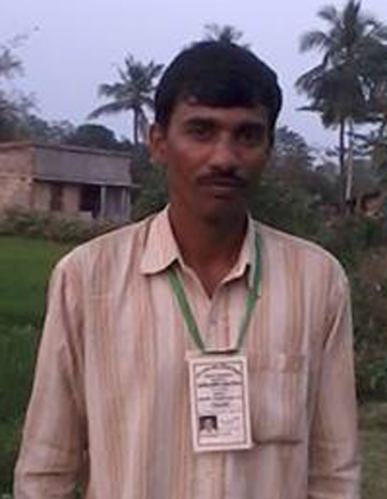
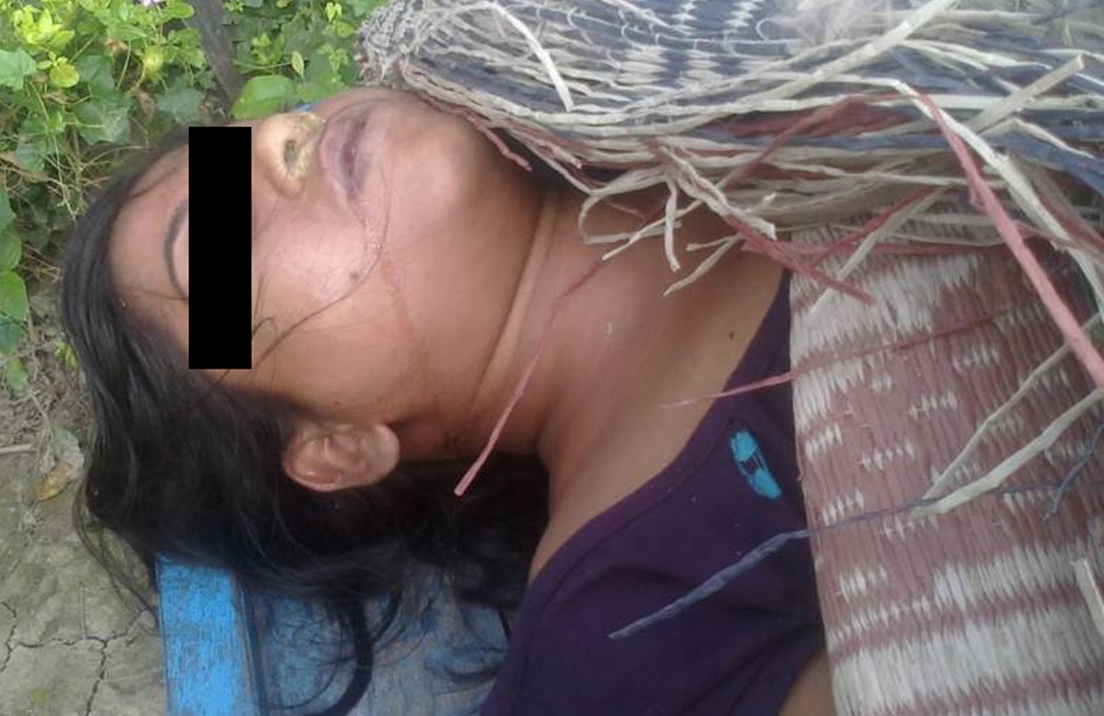

“AN” Injection Could Save
No NEOSTIGMINE may Kill Cobra bite Pt.
18 Vials of ASV could not save the Lady.
Always Try Atropine & Neostigmine one dose.
Joydev Mondal
of CJSS
Died after
20 Vials of ASV

Slide 20
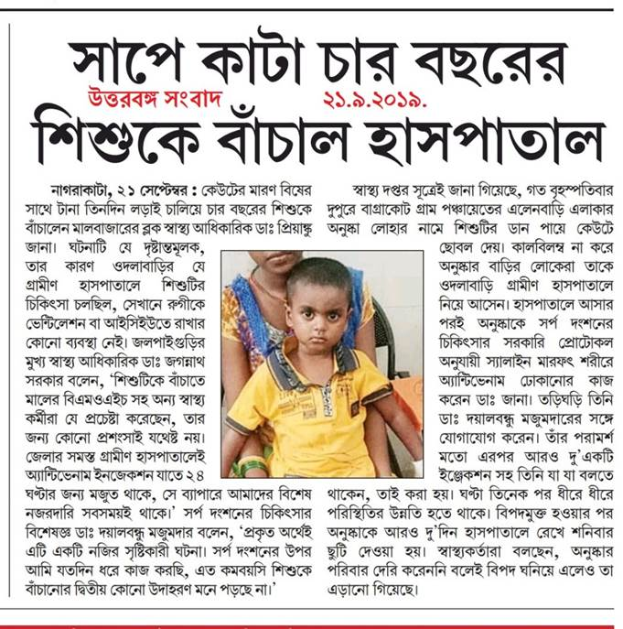
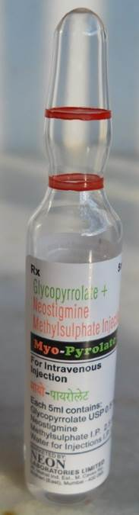
“AN” Injection Saved
4 yrs Girl, Cobra bite.
ASV and AN injections saved.
Repeated Myopyrolate injections.

Slide 21
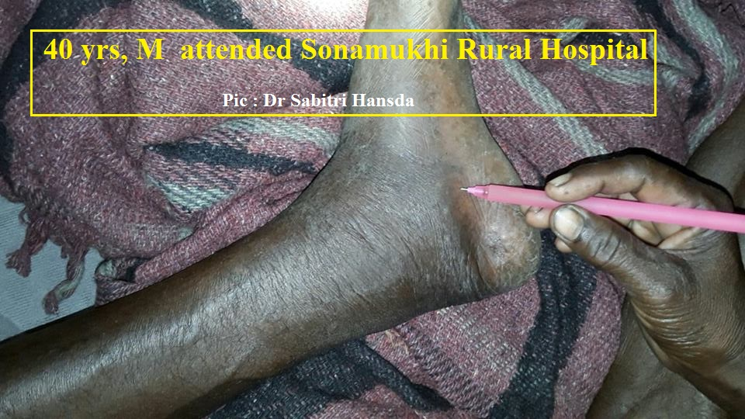
Dog Tooth ( ? ) - Hemotoxic signs
40 yrs, M . H/O : Dog Skeleton / Tooth - injury .
Sonamukhi Rural Hosp , after 4 hrs.
20WBCT = Not Clotted, ASV infused.
AKI at BSMC&H .

Slide 22
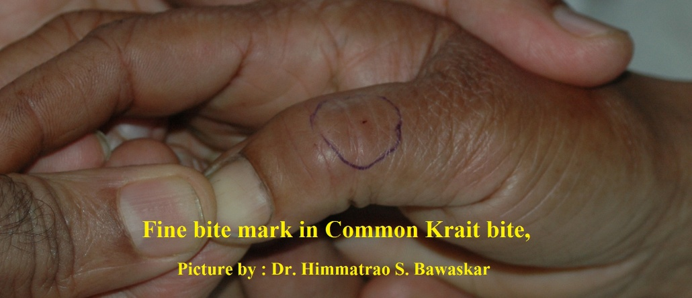
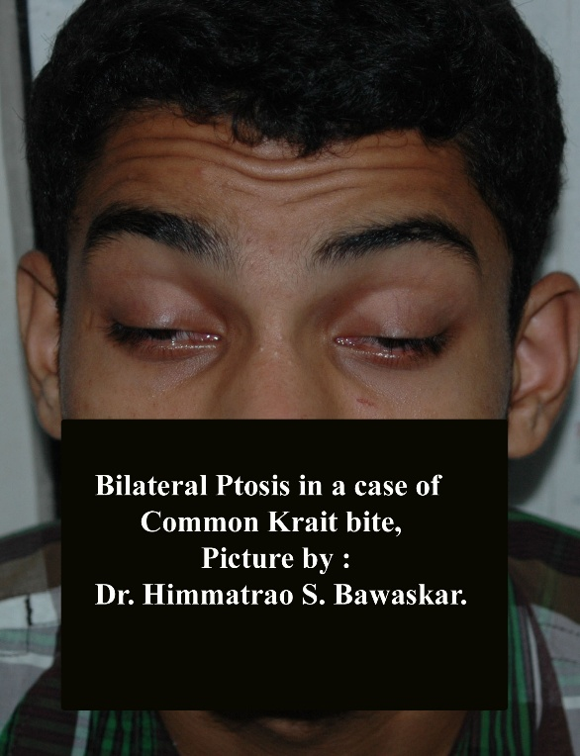
Krait Neurotoxicity
Painless Bite.
No local Sign.
Pain abdomen.
Pain in Throat. Pain in Joints.
Very slow Developing Bilateral Ptosis
Difficulty in Swallowing .
Slurred speech.
Tightness in chest.
Paradoxical respiration.
Respiratory failure.
CONVULSION

Slide 23
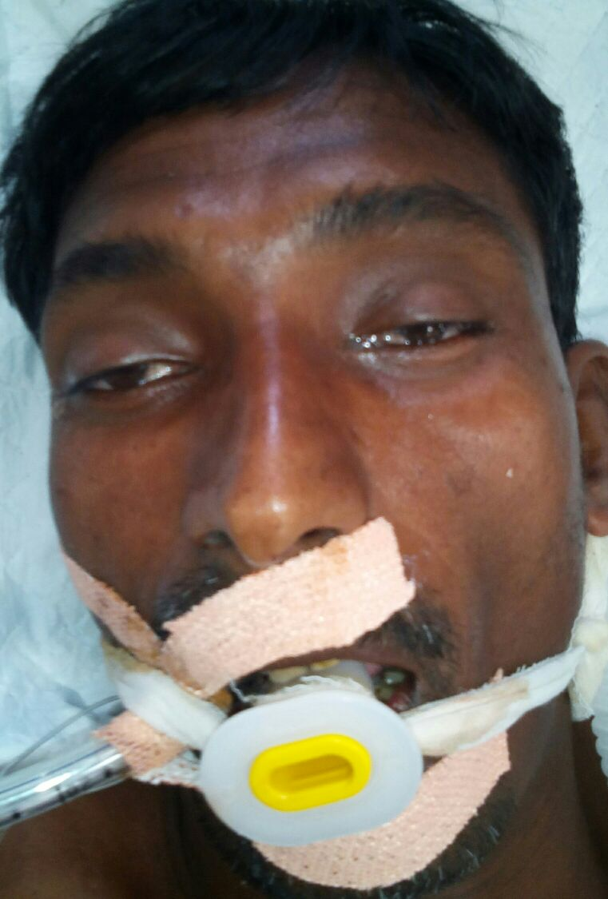
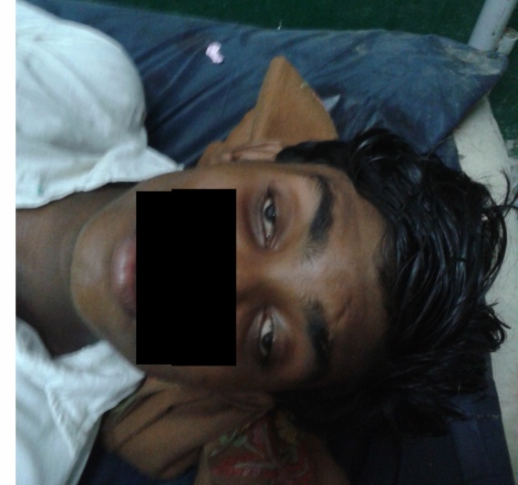
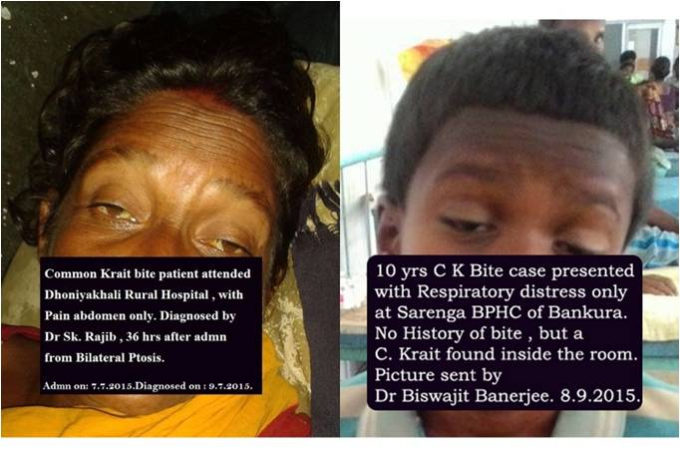
Mystery of Krait
99% bites in open floor bed ( in sleep).
Systemic sign may come after 2 –24 hrs.
May present with : sore throat , pain abdomen , arthralgia or vomiting only.
Acute bilateral Ptosis is the sign.
ASV at ptosis stage is life saving.

Slide 24
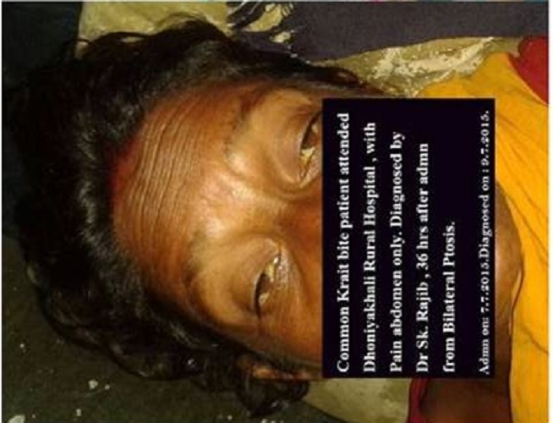
Bilateral Ptosis in Krait Bites
0 Hour 25 hours 38 hours
Detection of Ptosis at Different times

Slide 25
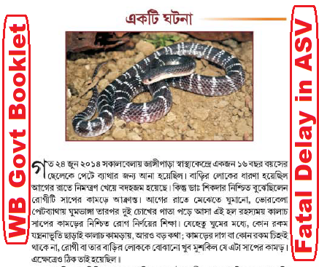
Mystery of Krait- Challenging
No Bite marks delayed ASV.
Timely Referral for Ventilation.
Diagnosis Ignored at Medical College.
Adverse Comment created Chaos .

Slide 26
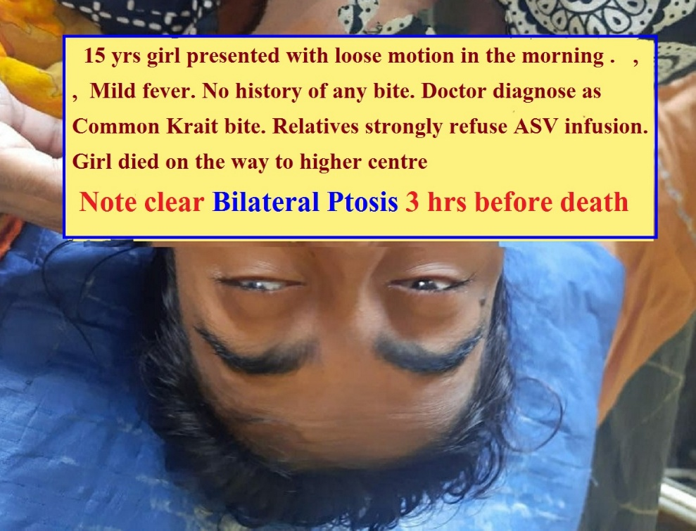
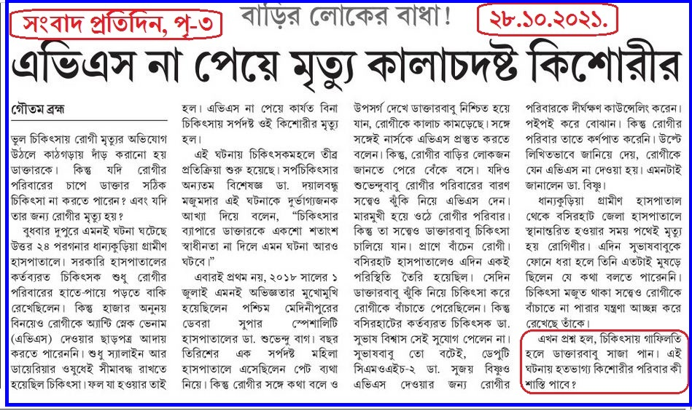
Krait bite Kills Again
No bite marks in C K bite misleading.
Delay in ASV infusion Fatal.
Honour the diagnosis of your doctor.

Slide 27
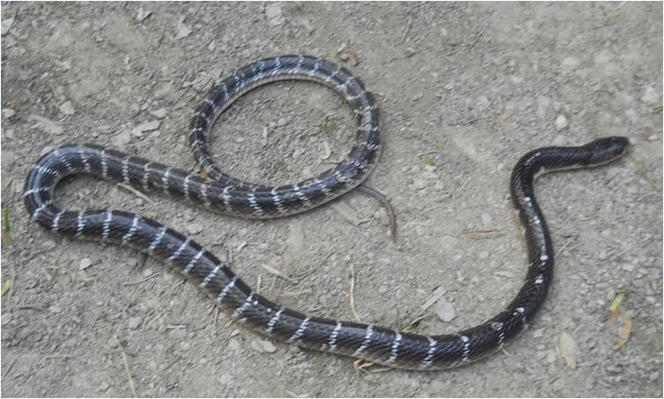
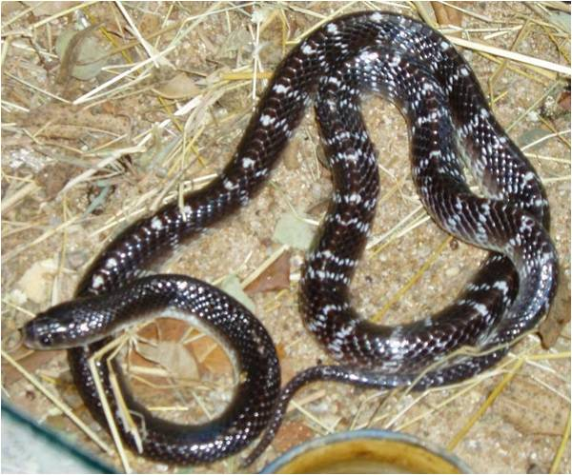
IDENTIFICATION of C.Krait
Non Hooded snake.
Average length 2.5 feet.
Glistening black colour.
Slender white bands over body .
Bands up to end of Tail.

Slide 28
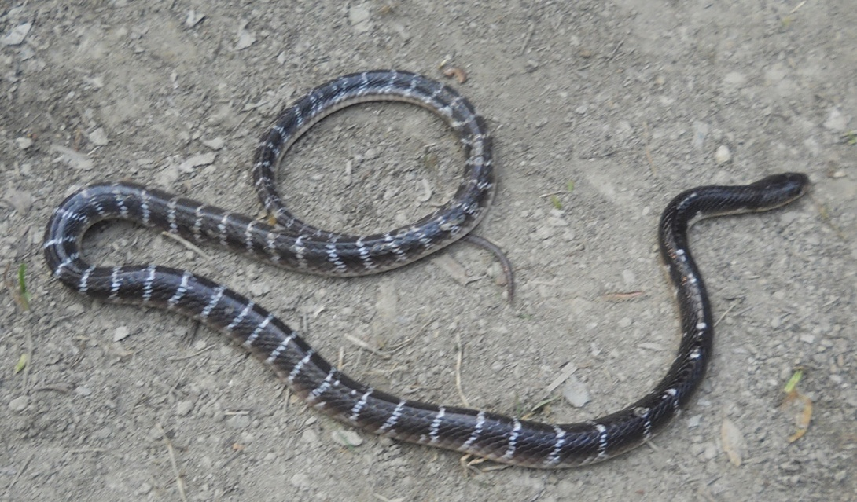

KRAIT Vs CHITI
Krait =Very Slender Bands, up to end of tail .
Chiti= Wider Bands starting from neck.
Krait = strictly night roaming, blackish .
Chiti = Grey to Saffron color. V at neck.

Slide 29


GOKHRO(Indian spectacled Cobra)
Also known as Kharish,AlGokhro, Dudh-kharish.
Attacking Temperament .
Spectacle mark on back of Hood.
Classical Neurotoxic Venom.

Slide 30

KEUTE (Ind. Monocled Cobra)
Also known as Alkeute , Kalkeute , Samukhbhanga .
Hood marked with a Lotus sign .
Angry & Attacking.
Neurotoxic venom.

Slide 31


CHANDRABORA(Russell’s Viper)
Hoodless Venomous Snake .
Sandal yellow coloured rings ( Chandra ) on body .
Wheesy sound on excitation .
Large Hollow Needle like Fangs .
Hemotoxic Venom. Also some Neuro sign. AKI kills.

Slide 32

Saw Scaled Viper ( ¼ Big 4 )
Not in WB ; Plenty in Mid & West India.
One of Big 4 for Poly-ASV production.
Smaller snake. Hemotoxic venom.
5 vials ASV to start.

Slide 33

4 Killers of WB
R.Viper, C.Krait & Two Cobras.
Same Indian Poly-ASV for all.
R.Viper : Hemo & Nephro Toxic venom.
R.V : Most unpredictable Treatment result.

Slide 34

Patient’s Love & Dr Surajit Giri
Dr S Giri, Anaesthesiologist But Snakebite Expert.
Resigned But Returned by HM & MD, NHM.

Slide 35
Take Home Message
Snakebite is a Life saving Emergency.
Every Doctor Must Treat Snakebite.
No Chance of Referral or 2nd Opinion.
Don’t forget Rule of 100.
Ambu Bag Ventilation at Emergency Room.
“AN” injection at ER for Cobra bite.
Pt in Bed with IV fluid then Remove Ligature.
10 Vials ( 100 ML) of ASV to start with.
Bite Marks and Brought Snake of No use.
Viper Bites may lead to AKI.

Slide 36
THANK YOU
www.kalachkrait.webs.com

