Slide 1
Atypical Snakebites
Dr Dayal Bandhu Majumdar
dayalbm@gmail.com
State Resource Person, W B ( S B Training)
www.kalachkrait.webs.com
9433104233.

Slide 2
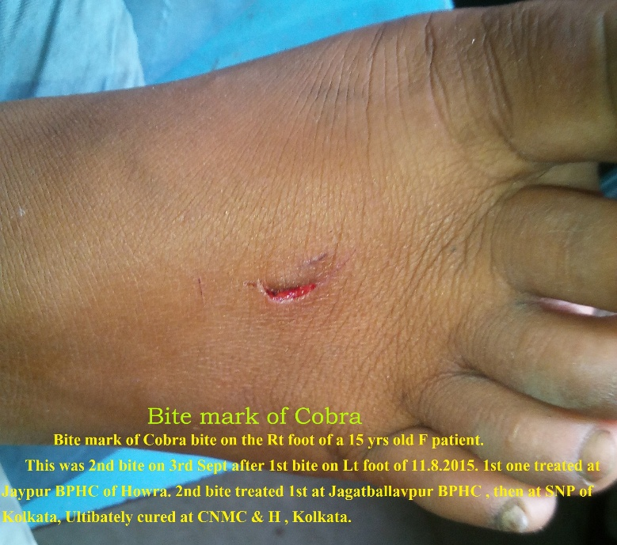
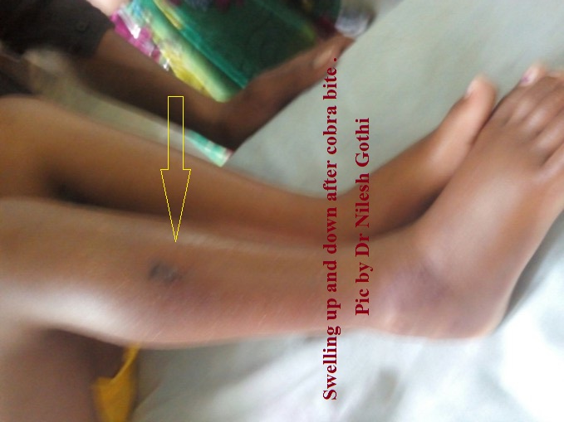
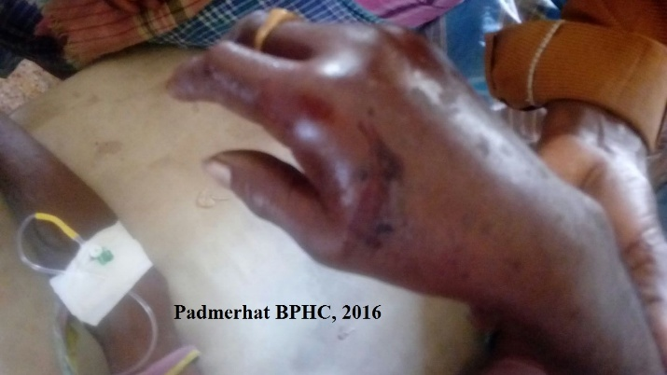
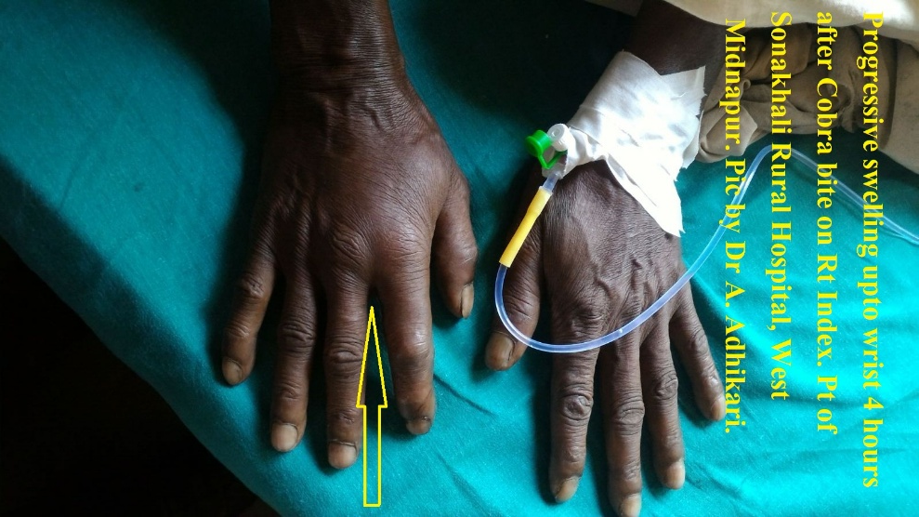
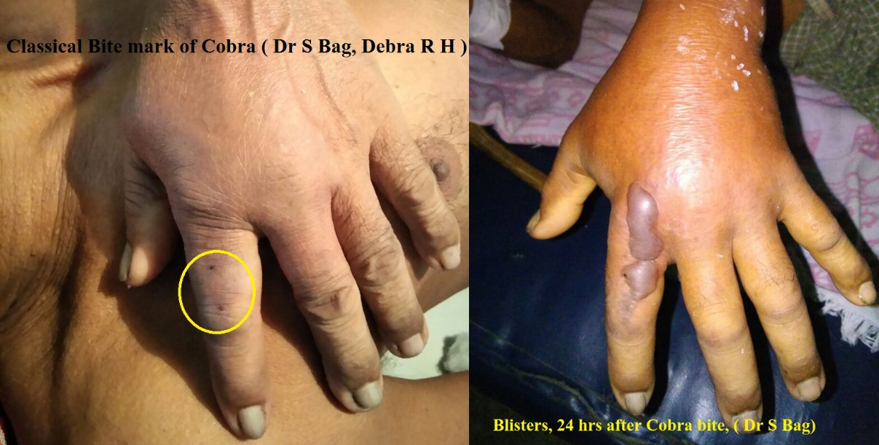
Cobra Local Signs
Variable Bite marks. Severe pain.
Progressive Swelling , Blisters.
Ulceration or necrosis.

Slide 3
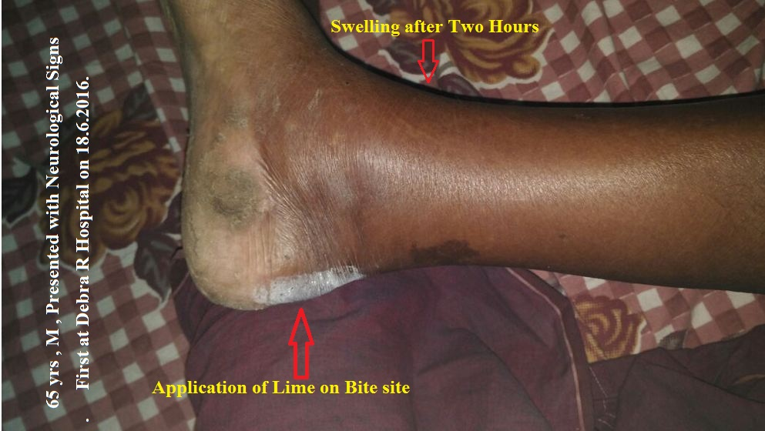
Cobra Atypical Signs
65 yrs ,M, Presented at Debra R H on 18.6.16.
First Symptom, Weakness of Face & Eye Lids.
No Pain Complaint , revealed on Questioning.
Dramatic Improvement by AN Inj.

Slide 4
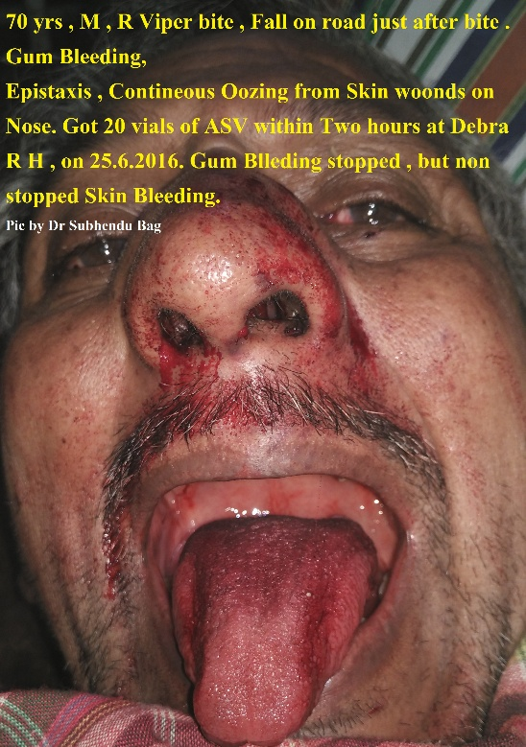
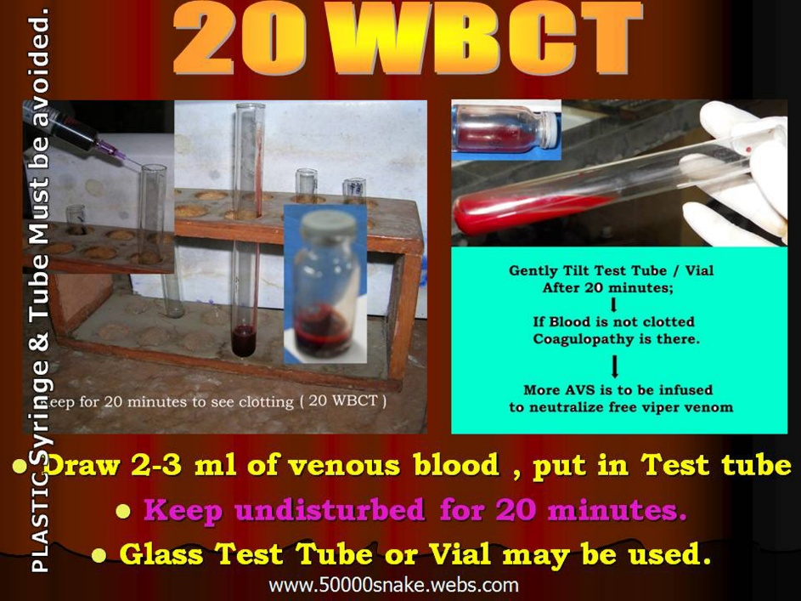
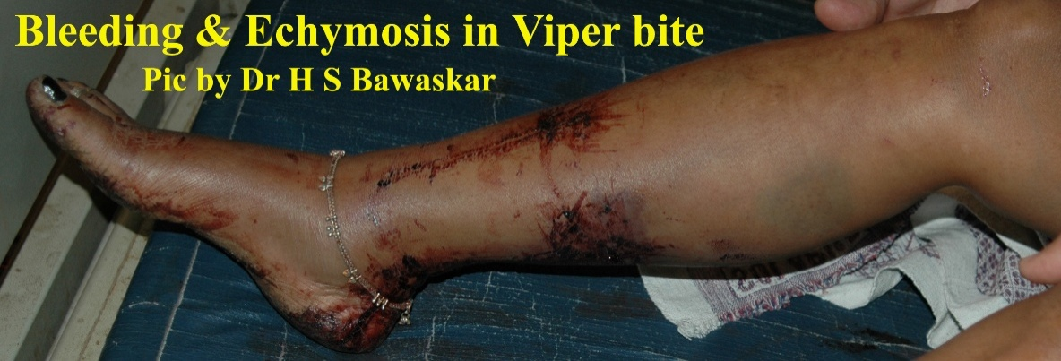
Typical Hemotoxic Snakebites
Pain and Slow Swelling.
Sometimes ignored.
Bleeding from any site.
Clotting Disorder.
Late Hematuria.
Oliguria.
Acute Renal failure.

Slide 5
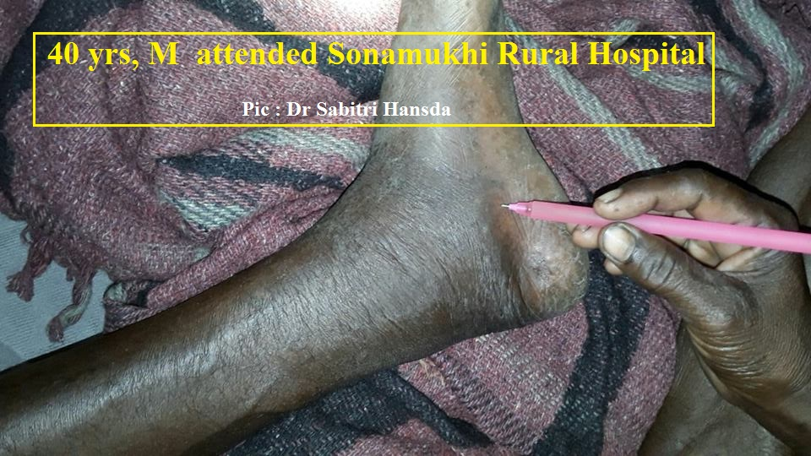
Dog Tooth ( ? ) - Hemotoxic signs
40 yrs, M . H/O : Dog Skeleton / Tooth - injury .
Sonamukhi Rural Hosp , after 4 hrs.
20WBCT = Not Clotted, ASV infused.
AKI at BSMC&H .

Slide 6
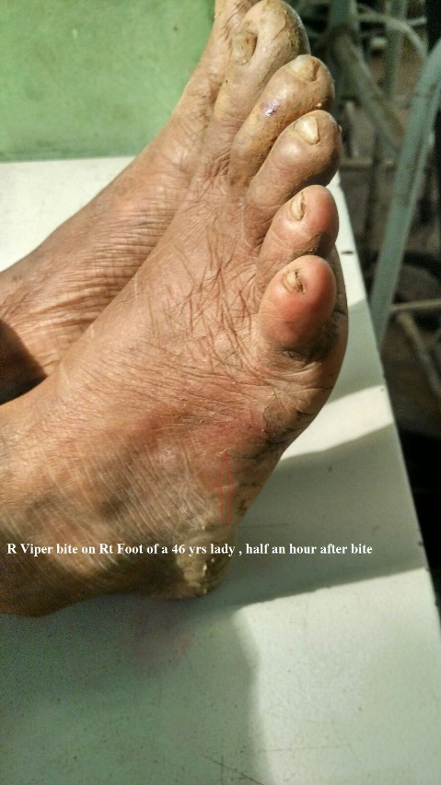
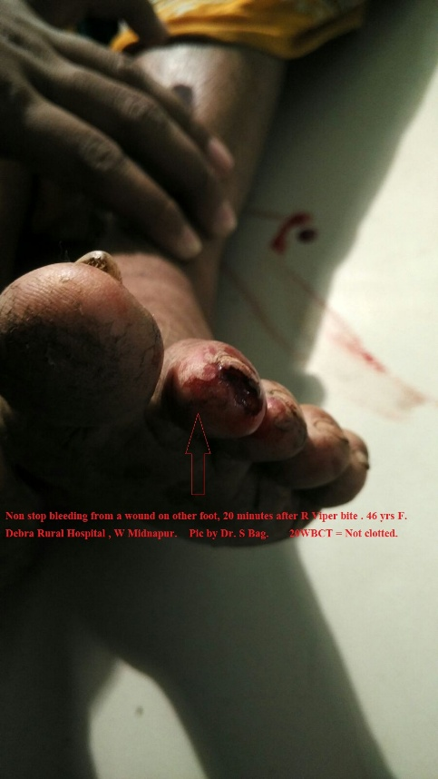
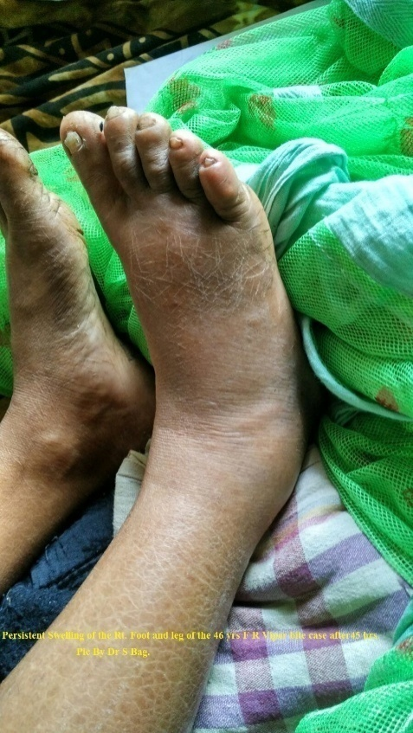
Early Hemotoxic Sign- DEBRA
Date of bite : 20.11.2015. Treated by . Dr Subhendu Bag
46 yrs, F . Bite at 11.40 am, Hospital at 12.00 Noon.
Tiny injury on other foot; bleeding non stop.
Pain & Swelling on Bitten foot. 20WBCT= Not Clotted.
Total 20 vials of ASV. Only swelling after 6 hrs.
Blood Biochem normal all along. Cured at Debra R H .

Slide 7
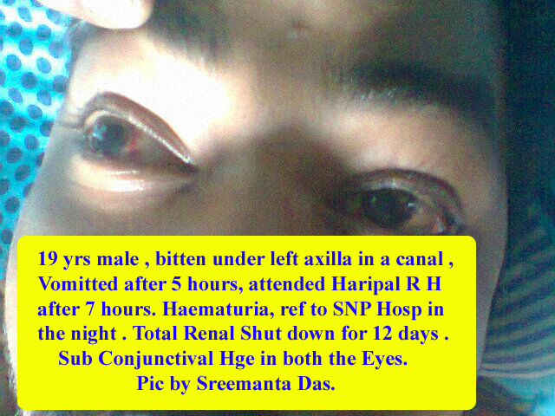
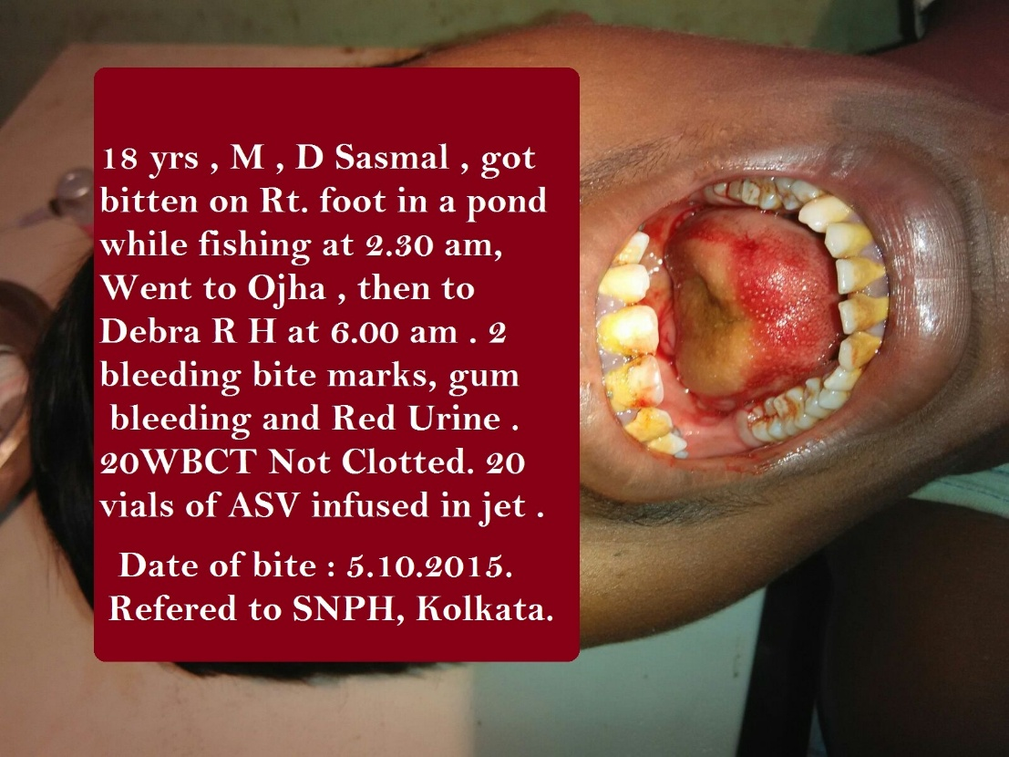
Too Late Presentation
(?) Insect Bite at 10.00 am
Vomiting at 4.00 PM
20WBCT Done at 6.00 PM
Sub-Conj Hge after 2 days.
15 HD Saved..

Slide 8
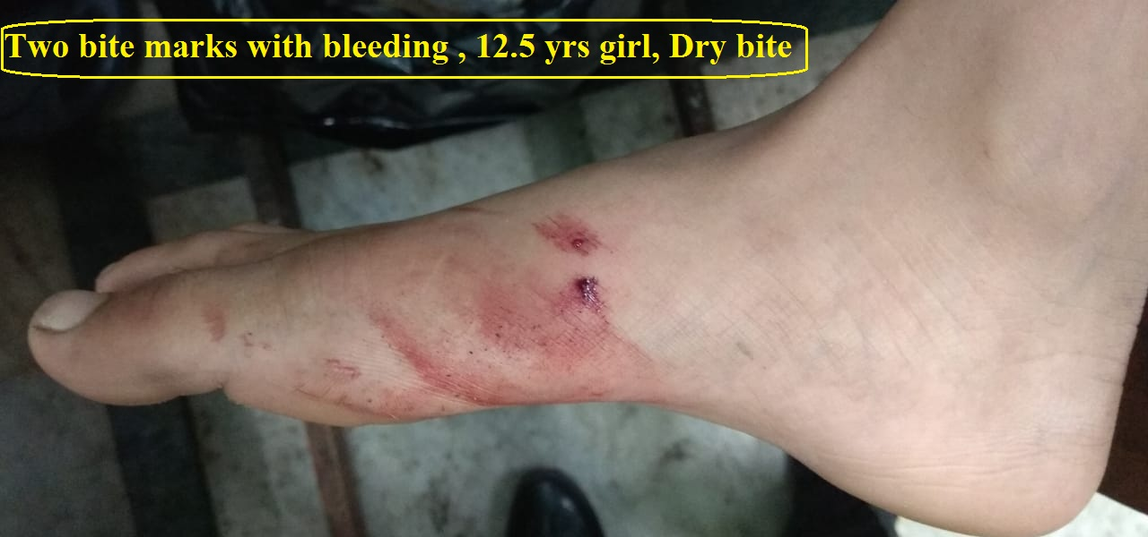
BITE MARKs – Not Significant
Bite marks are of no significance.
Never search for bite marks.
Bite marks with Dry Bites possible.
No bite marks – C Krait bite possible

Slide 9
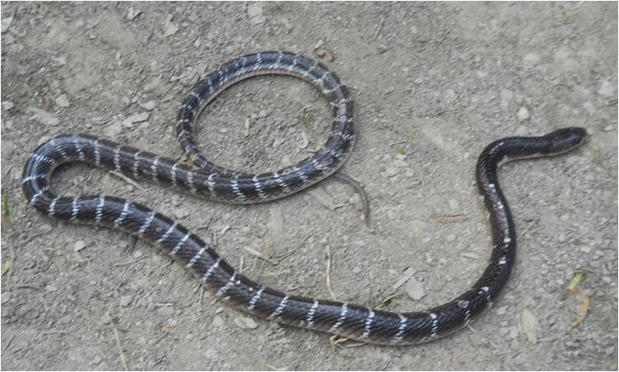
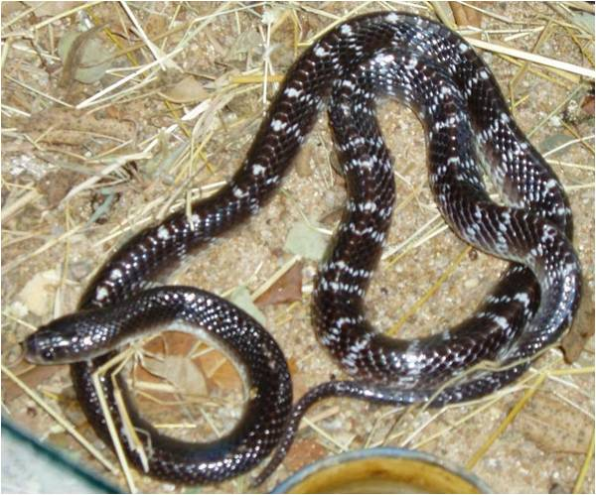
IDENTIFICATION of C.Krait
Non Hooded snake.
Average length 2.5 feet.
Glistening black colour.
Slender white bands over body .
Bands up to end of Tail.

Slide 10
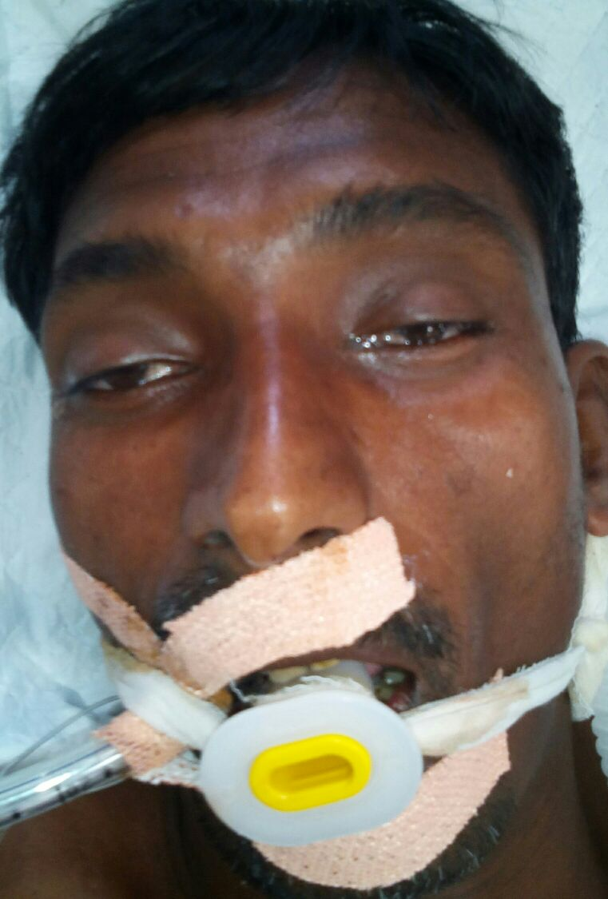
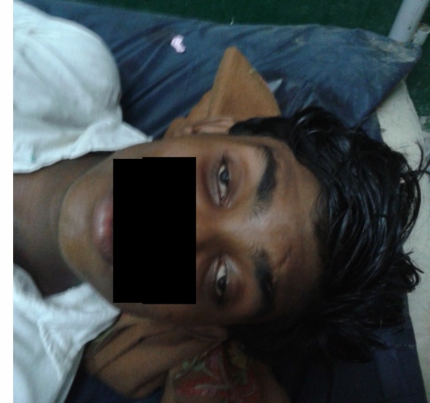
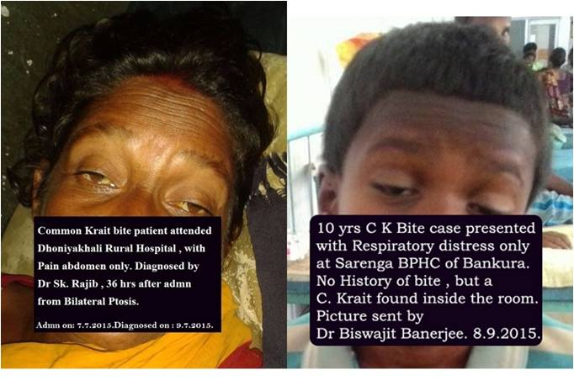
Mystery of Krait
99% bites in open floor bed ( in sleep).
Systemic sign may come after 2 –24 hrs.
May present with : sore throat , pain abdomen , arthralgia or vomiting only.
Acute bilateral Ptosis is the sign.
ASV at ptosis stage is life saving.

Slide 11
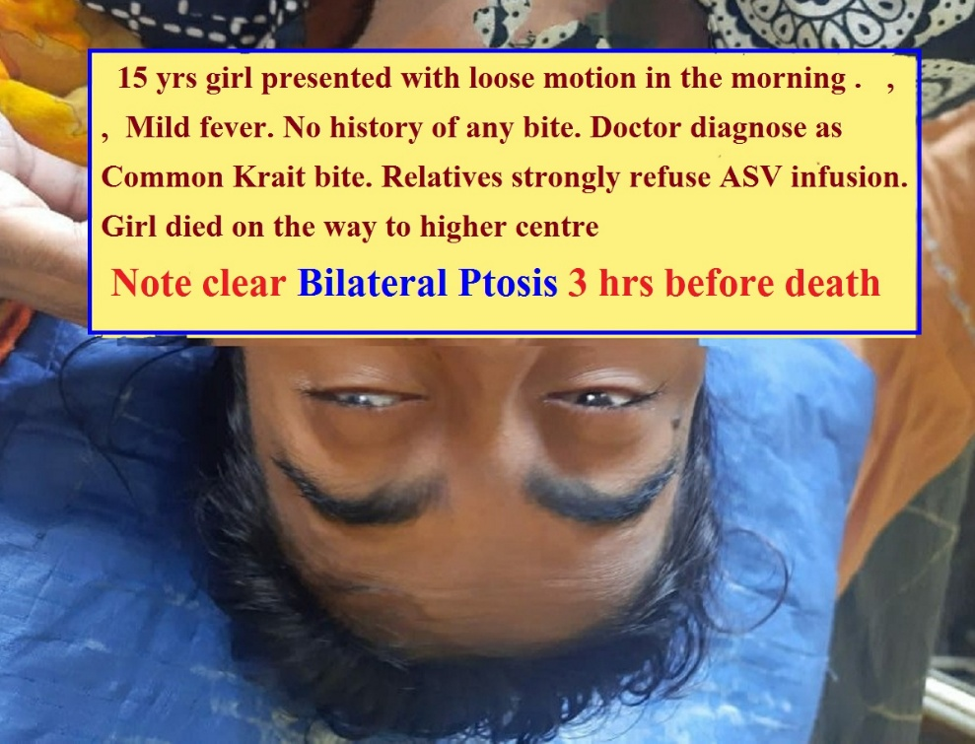
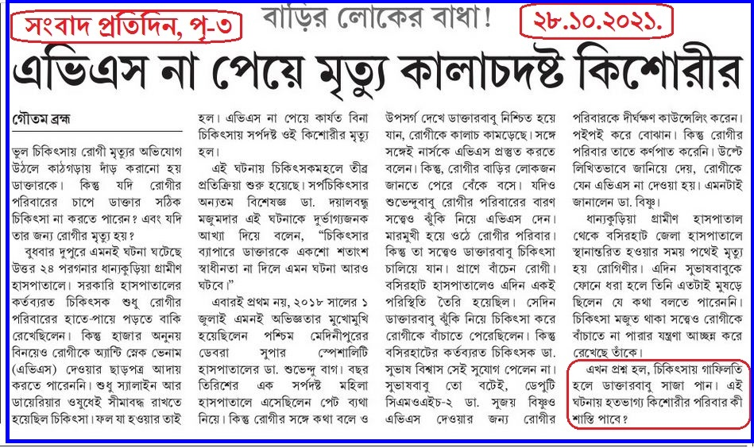
Krait bite Kills Again
No bite marks in C K bite misleading.
Delay in ASV infusion Fatal.
Honour the diagnosis of your doctor.

Slide 12
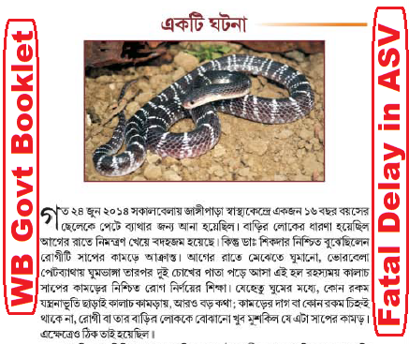
Mystery of Krait- Challenging
No Bite marks delayed ASV.
Timely Referral for Ventilation.
Diagnosis Ignored at Medical College.
Adverse Comment created Chaos .

Slide 13
THANK YOU
www.kalachkrait.webs.com

